Slide 1
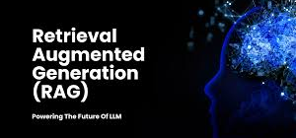
CHATBOT USING RAG MODEL

Slide 2
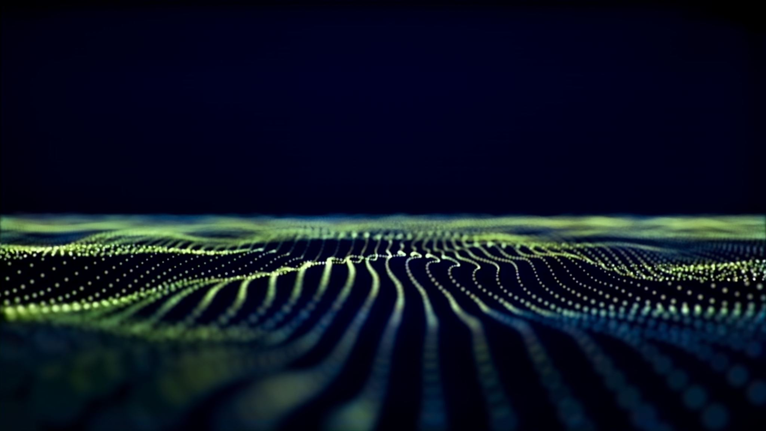
OVERVIEWOF PRESENTATION
INTRODUCTION
ABSTRACT
PROBLEM STATEMENT
IMPLEMENTATION
STANDARDS ADOPTED
FUTURE SCOPE
CONCLUSION

Slide 3
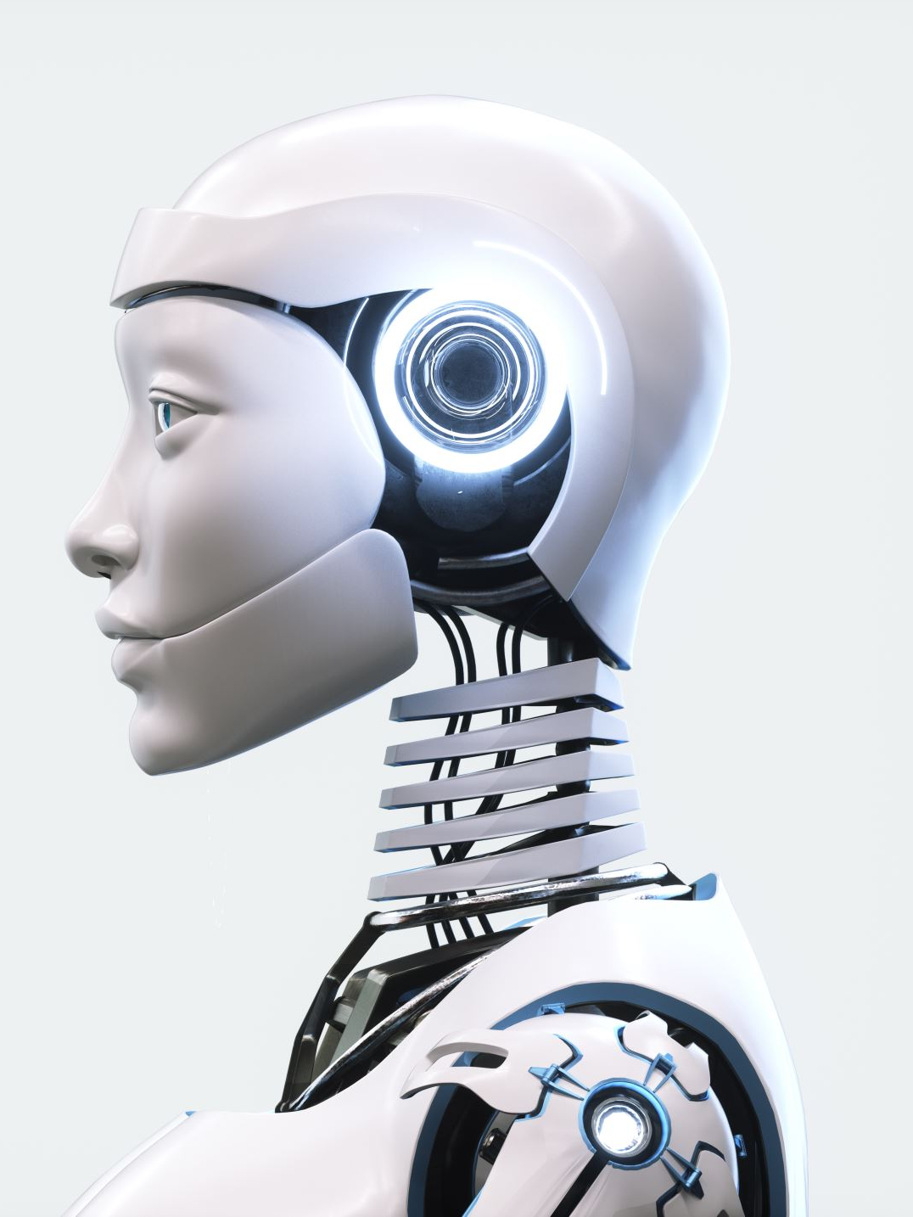
INTRODUCTION
In recent years, conversational AI has evolved rapidly, enabling more intelligent and context-aware chatbot systems. Traditional chatbots often rely solely on generative language models, which may produce fluent but factually inaccurate responses, especially when queried about specific or dynamic information. To address this challenge, Retrieval-Augmented Generation (RAG) has emerged as a powerful hybrid approach that combines the strengths of information retrieval and natural language generation.
This project explores the development of a chatbot leveraging the RAG architecture, which dynamically retrieves relevant documents from a knowledge base and integrates that information into generated responses. By grounding the generation process in real, retrieved data, the chatbot enhances both accuracy and contextual relevance.

Slide 4

ABSTRACT
This project presents the development of an intelligent chatbot system based on the Retrieval-Augmented Generation (RAG) model, which combines the strengths of retrieval-based and generative language models. Unlike traditional chatbots that rely solely on pre-trained language models for generating responses, the RAG-based chatbot retrieves relevant context from an external knowledge base before generating answers, leading to more accurate, informed, and contextually relevant responses.
The architecture integrates a dense retriever to fetch top-ranked documents and a generative model that synthesizes this retrieved information into coherent replies. This method significantly reduces hallucinations and improves factual consistency in responses. The system is further enhanced using the GROQ API for high-speed inference, allowing real-time interaction with users while maintaining high performance and low latency.

Slide 5
ENHANCING DOCUMENT INTERACTION
Growing Information Volume
The amount of data stored in documents, especially PDFs, is increasing rapidly, posing retrieval challenges.
Inefficiencies in Traditional Search
Standard keyword searches often yield irrelevant results, forcing users to sift through documents manually.
Need for Intelligent Systems
There is a pressing need for systems that understand user queries semantically, enhancing search efficiency.
Limitations of Current Tools
Existing document search tools often fail to comprehend semantic meanings, leading to missed information.
Introduction of DocuQuery
Chatbot using Rag Model leverages a Retrieval Augmented Generation approach to improve document information retrieval.
RAG Approach Explained
Combining retrieval systems with language models, RAG offers contextual, coherent responses to queries.
Benefits for Various Contexts
This technology enhances efficiency in academic, business, and personal document management.

Slide 6

PROBLEM STATEMENT
Traditional chatbots that rely solely on generative models often produce responses that are fluent but lack factual accuracy. These models generate text based on pre-trained knowledge and may hallucinate incorrect information, leading to unreliable or misleading responses.
1
To address this issue, there is a need for an intelligent chatbot that can:
2
Retrieve relevant and up-to-date information from a structured knowledge base.
3
Generate contextually rich and factually accurate responses.
4
Provide real-time, low-latency answers for better user experience.
5
This project aims to develop a Retrieval-Augmented Generation (RAG) based chatbot, which combines the capabilities of information retrieval with natural language generation. By integrating a retriever module to fetch relevant context and a generator module to synthesize meaningful responses,
6

Slide 7

How RAG Model Solves the Problem
1. Reduces Hallucinations
Traditional language models generate text based on learned patterns, which can lead to fabricated or inaccurate responses.
RAG retrieves real, grounded information from a knowledge base before generating the response, reducing the chance of hallucinations.
2. Provides Factually Accurate Answers
By retrieving relevant documents or passages at inference time, RAG ensures that the generated answers are based on actual data, improving factual correctness.
3. Enhances Contextual Relevance
The generator in RAG uses the retrieved context to craft more relevant, topic-aware responses, even for complex or domain-specific queries.
4. Supports Dynamic & Updatable Knowledge
Unlike static models trained on fixed data, RAG can access updated knowledge bases, making the chatbot more current without needing full retraining.
5. Combines the Best of Both Worlds
Retriever: Brings precision by fetching accurate documents.
Generator: Adds fluency and human-like understanding.

Slide 8

ESSENTIAL CONCEPTS OF OUR PROJECT
Retrieval Augmented Generation (RAG)-RAG combines retrieval and generation for accurate, up-to-date responses.
Retrieval Component-Indexes and retrieves relevant information from PDF documents based on queries.
Generation Component-Generates coherent responses using the retrieved information for user queries.
Vector Embeddings-Numerical text representations capturing semantic meaning in high-dimensional space.
FAISS Indexing-Infrastructure for efficient similarity search and clustering of dense vectors.
Large Language Models (LLMs)-LLMs synthesize information and generate coherent responses from retrieved passages.

Slide 9
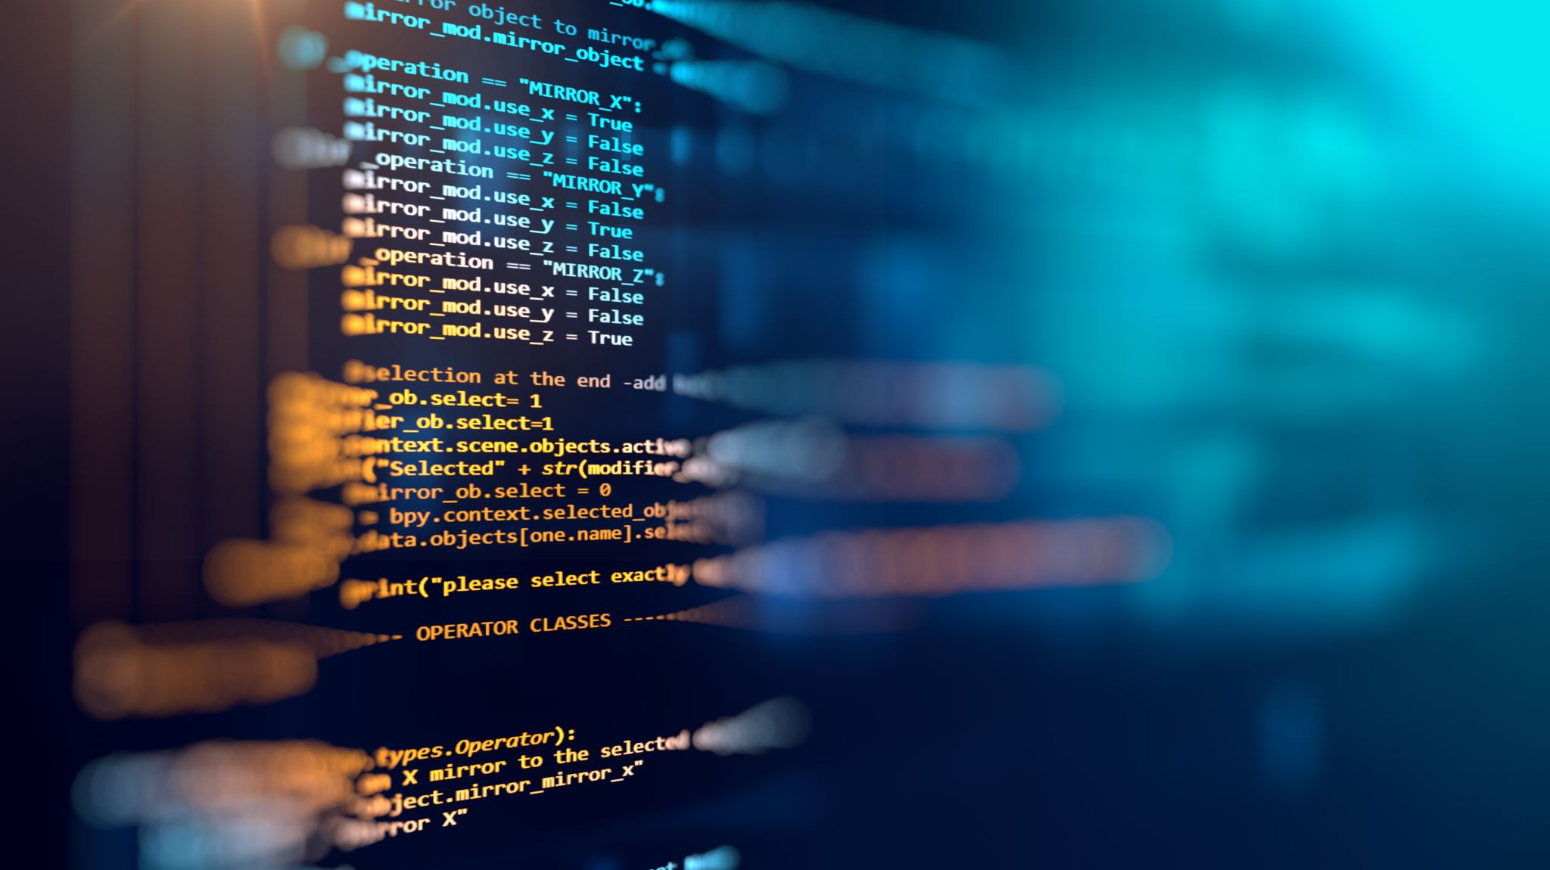
IMPLENTATION
1. Data Collection & Knowledge Base Setup
Gather domain-specific documents, FAQs, or structured/unstructured data.
Convert text data into vector embeddings using models like SBERT or BERT.
Store the embeddings in a vector database (e.g., FAISS, Pinecone, Elasticsearch).
2. Implementing the Retrieval Module
Use a dense retriever (e.g., FAISS, BM25, or DPR) to fetch relevant documents.
Apply semantic search using cosine similarity or nearest-neighbor search.
3. Implementing the Generation Module
Use a pre-trained transformer model (e.g., T5, BART, GPT-3.5) for response generation.
Provide retrieved documents as additional context to improve response accuracy.
4. Integration with GROQ API
Connect the chatbot backend with GROQ API for high-speed inference.
Ensure low-latency response handling for real-time chatbot interaction.
5. Backend Development
Develop the backend using Flask/FastAPI/Django to handle API requests.
Implement session management, caching, and error handling.

Slide 10

Project Development Planning and Analysis
Define the Problem Statement-Traditional chatbots that use only generative models often produce responses that sound fluent but may lack factual accuracy or real-time relevance. Users need intelligent conversational agents that not only understand natural language but also respond with grounded, verifiable information. The core problem is how to build a chatbot that generates accurate, context-aware responses by leveraging external knowledge sources.
1
Gather User Requirements-Understanding the end-users’ expectations is crucial. Users may include customers, students, employees, or general users who expect quick, intelligent, and helpful responses. This step involves collecting feedback and insights into how the chatbot will be used, what kind of questions it should handle, and what performance standards it must meet.
2
Analyze Requirements-Once user needs are gathered, the next step is to translate them into technical requirements. This involves analyzing what kind of data the chatbot needs to retrieve, how it should integrate with the knowledge base, and what constraints (like latency or security) need to be considered.
3
Plan Project Steps-After requirement analysis, a clear roadmap for development is created. This includes dividing the project into phases with specific goals, timelines, tools, and resource allocations.
4
Design System Architecture-This step outlines how all components will work together technically. For a RAG-based chatbot, the architecture should define how queries flow through retrieval and generation components, how data is stored and accessed, and how APIs interact.
5

Slide 11

FUTURE SCOPE
Support for Additional File Formats – Expanding support beyond PDFs to cover DOCX, and HTML would make the system more versatile.
2. Advanced Document Processing – Implementing Optical Character Recognition (OCR)
would enable the system to pull text out of scanned documents and images.
3. Multi-Language Capability – Implementing support for multiple languages would make the
system applicable in international contexts.
4. User Accounts and Document Management – Adding user authentication and persistent
storage would enable users to store documents, retain query history, and manage their content effectively.
5. Enhanced Visual Features – Adding document previews, highlighted text in the response, and
interactive navigation would enhance the overall user experience.
6. Mobile App Development – Developing a mobile-friendly version of the system would make it
possible for users to access Chatbot using RAG model on the move.
7. Enterprise Integration – Creating connectors for enterprise document management systems
would enable businesses to incorporate DocuQuery into current workflows.

Slide 12

A Retrieval-Augmented Generation (RAG) based chatbot effectively combines the accuracy of information
retrieval with the fluency of generative models, resulting in more reliable and context-aware responses.
The integration of a retriever module enables the chatbot to pull relevant knowledge from external sources,
reducing hallucinations and improving factual correctness.
Using GROQ API ensures fast and scalable inference, making the chatbot suitable for real-time applications with
minimal latency.
The system architecture is modular and scalable, allowing for future enhancements like domain-specific tuning,
multilingual support, or expansion of the knowledge base.
The chatbot successfully meets user expectations for responsiveness, accuracy, and conversational fluency,
proving its potential in domains like customer support, education, and knowledge management.
Overall, this project demonstrates the power of combining modern NLP techniques with high-performance
infrastructure to build next-gen conversational AI systems.

Slide 13
THANKING YOU
SWATTIK HALDER 2206223

